Slide 1
Project 3 - CAPM
TEAM 16:-
ADARSH RAJ SHRIVASTAVA (B21AI003)
ASHUTOSH (B21AI007)
PRAKHAR GUPTA (B21AI027)
SALONI GARG (B21AI036)
Mentors-
Vivek Vijay
Naveen Kumar

Slide 2
Outline
Selected risk free asset as PPF with 7.1% annual return (0.019% daily).
Choose 10 risky assets - Stock = ['AAPL', 'MSFT', 'GOOGL', 'AMZN', 'CSCO', 'TSLA', 'NVDA', 'JPM', 'GS', 'NFLX']
Utilize the Capital Asset Pricing Model (CAPM) formula to calculate the expected return for each of the 10 risky assets.
Computed the Capital Market Line (CML) equation using the CAPM model.
Plotted the efficient frontier and CML.
Tangency line on efficient frontier.
3 risky assets for individual Security Market Lines - ['NVDA', 'AAPL', 'TSLA']
Performance Metrics - Sharpe Ratio, Treynor Ratio
Compare and contrast the portfolios

Slide 3
Datasets
Apple (AAPL)
Microsoft (MSFT)
Alphabet Inc. (Formerly Google) (GOOGL)
Amazon (AMZN)
Cisco (CSCO)
Tesla (TSLA)
Nvidia (NVDA)
JP Morgan (JPM)
Goldman Sachs (GS)
Netflix (NFLX)

Slide 4
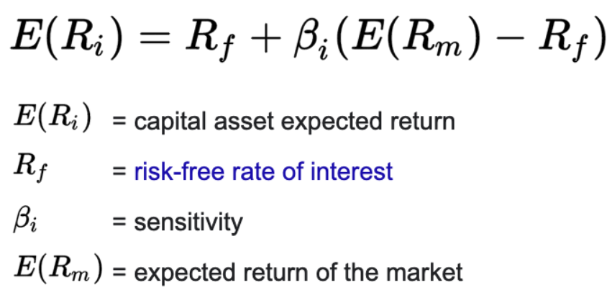
Important terms used
Portfolio : A combination of different assets held in a specific proportion to achieve a desired risk-return profile.
Return of Portfolio : The return of a portfolio represents the gain or loss on an investment over a specific period.
Risk of Portfolio : The risk of a portfolio measures the uncertainty or variability of returns associated with the portfolio.
Efficient Frontier : A set of portfolios that offer the maximum expected return for a given level of risk or the minimum risk for a given level of return.
Formula-

Slide 5
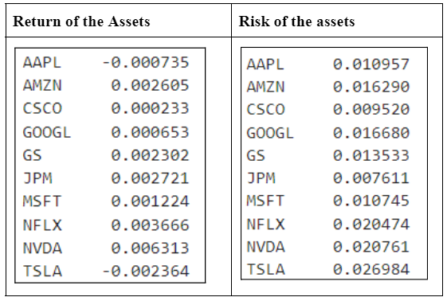
Return and Risk of the Assets

Slide 6
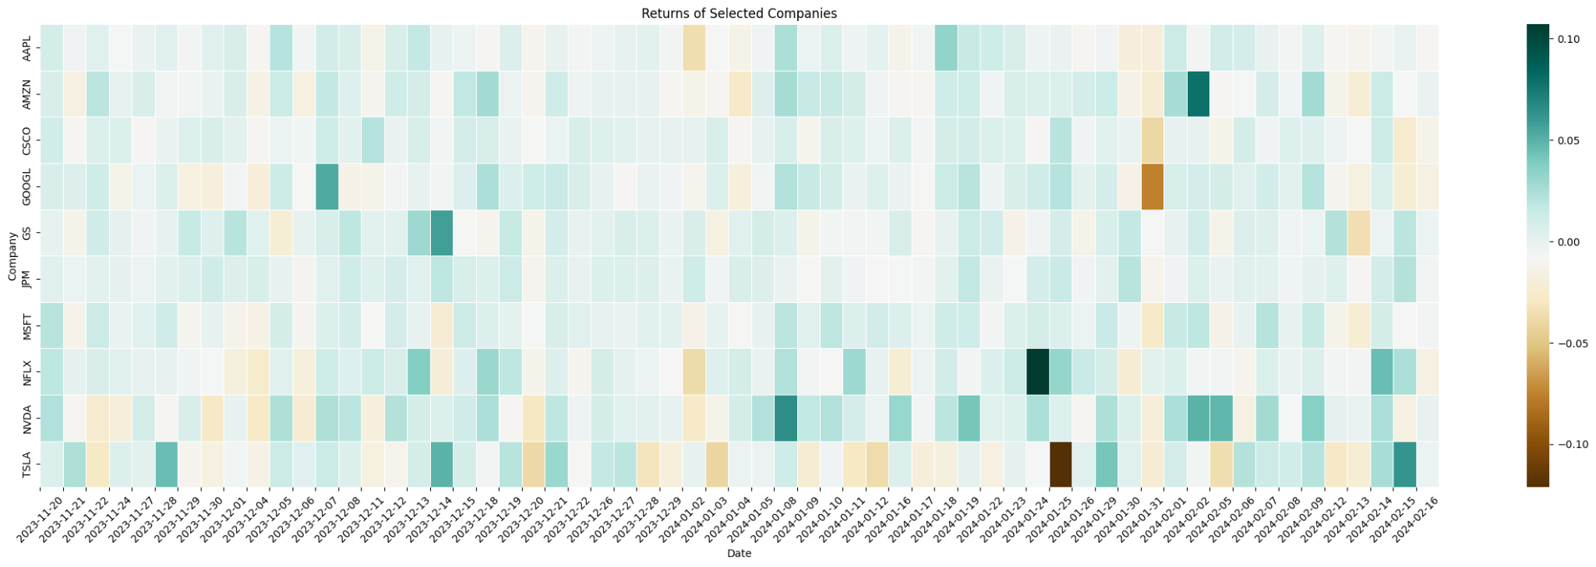
Visualizing Returns of Assets

Slide 7
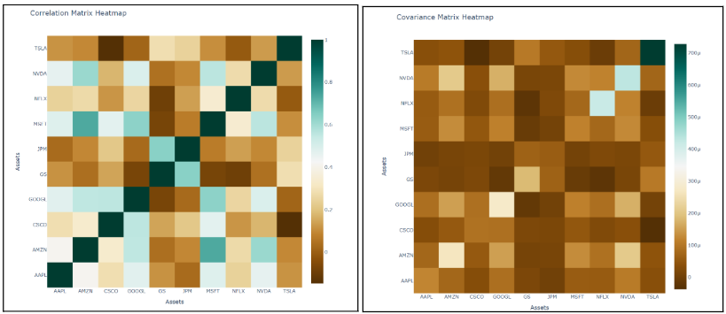
Correlation and Covariance of Return and Risk

Slide 8
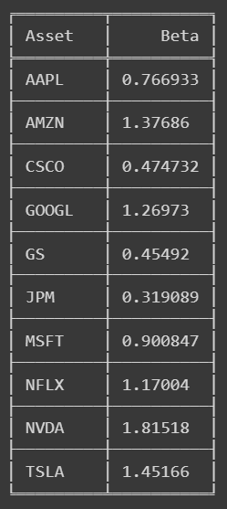
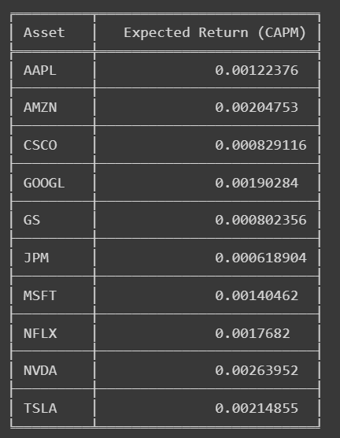
CAPM Expected return Calculation

Slide 9
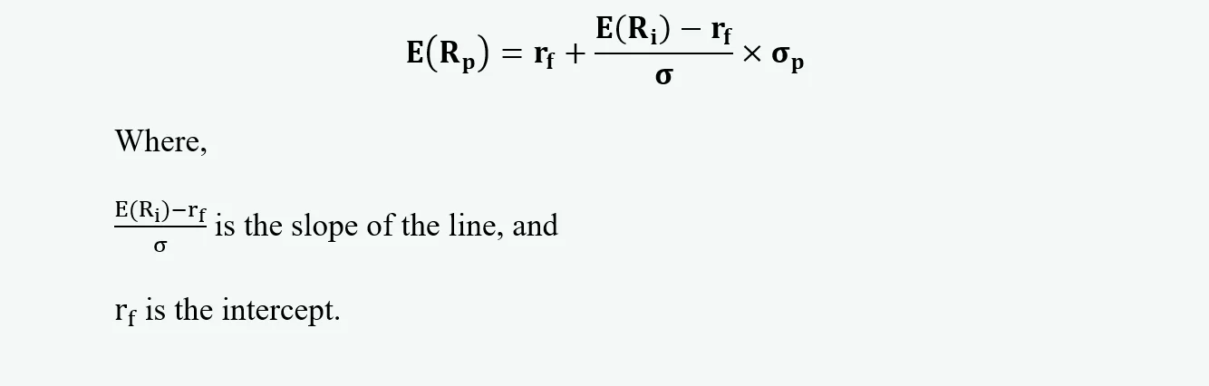
CML Equation

Slide 10
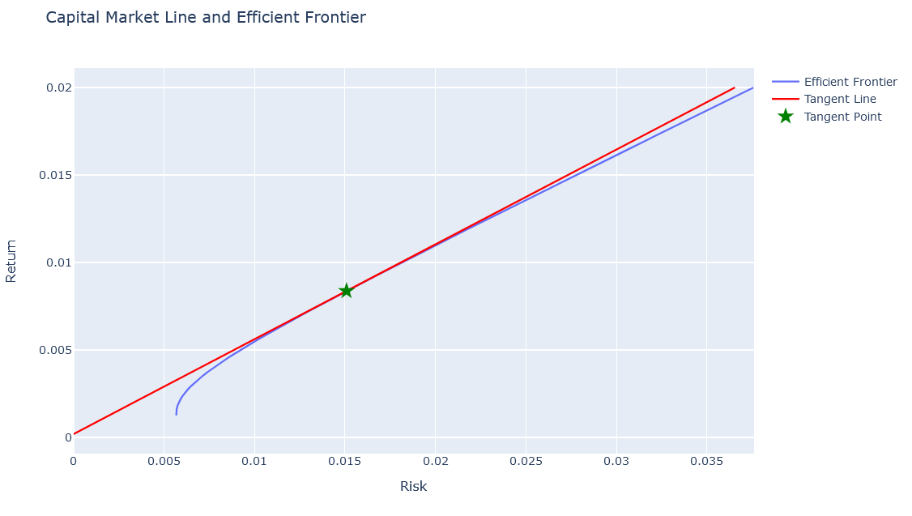
Plot - Efficient Frontier & CML

Slide 11
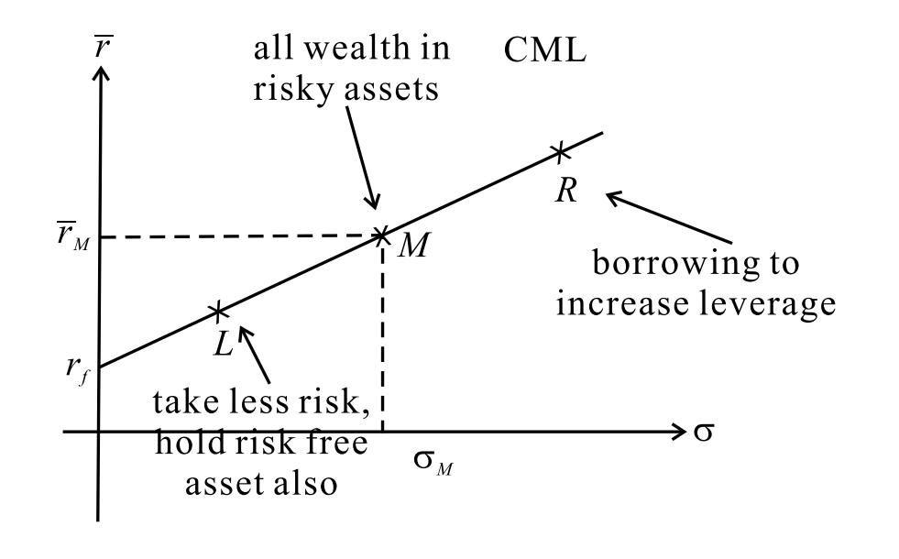
Tangency Point
CML is the tangent line drawn from the risk free point to the feasible region for risky assets. This line shows the relation between rP and σP for efficient portfolios (risky assets plus the risk free asset).
The tangency point on the efficient frontier where the Capital Market Line (CML) touches it represents the one of the two endpoints of line of optimal portfolio
The significance lies in providing the highest possible return per unit of risk, represented using different ratio eg Sharpe Ratio.

Slide 12
3 Stocks chosen for SML
Apple (AAPL)
Tesla (TSLA)
Nvidia (NVDA)

Slide 13
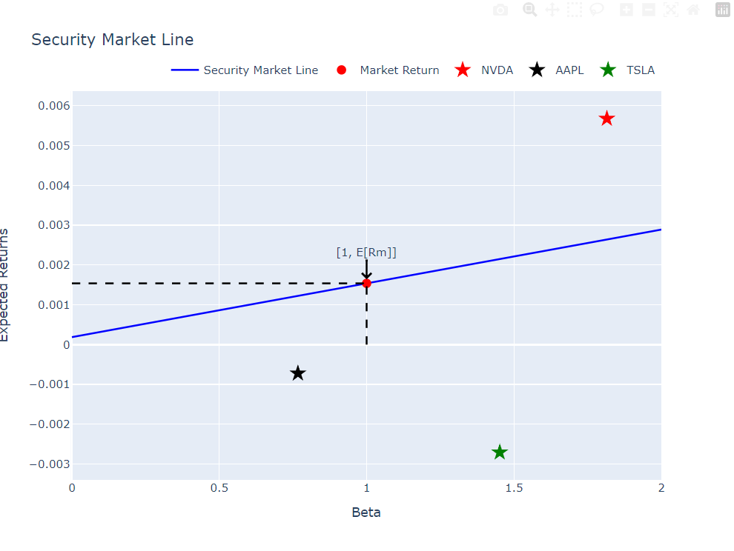
SML for ['NVDA', 'AAPL', 'TSLA']
Undervalued
Overvalued

Slide 14
Performance Metrics
Sharpe Ratio
Treynor Ratio

Slide 15
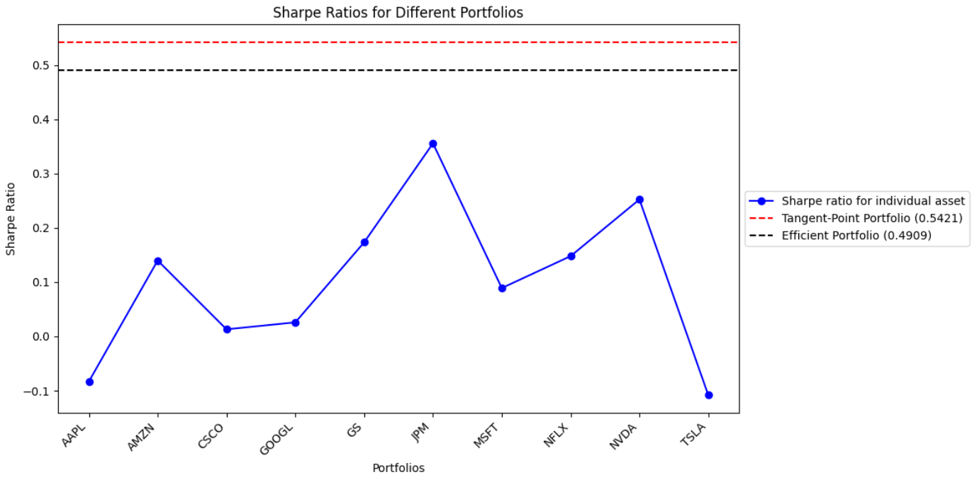
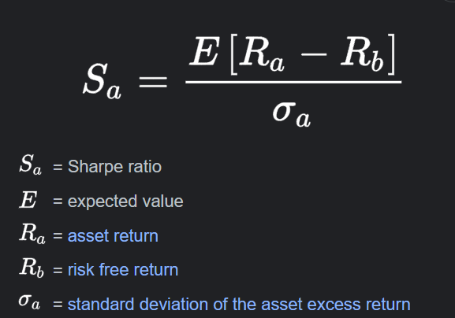
Sharpe Ratio
The Sharpe ratio is a measure of risk-adjusted return. It describes how much excess return you receive for the volatility of holding a riskier asset

Slide 16
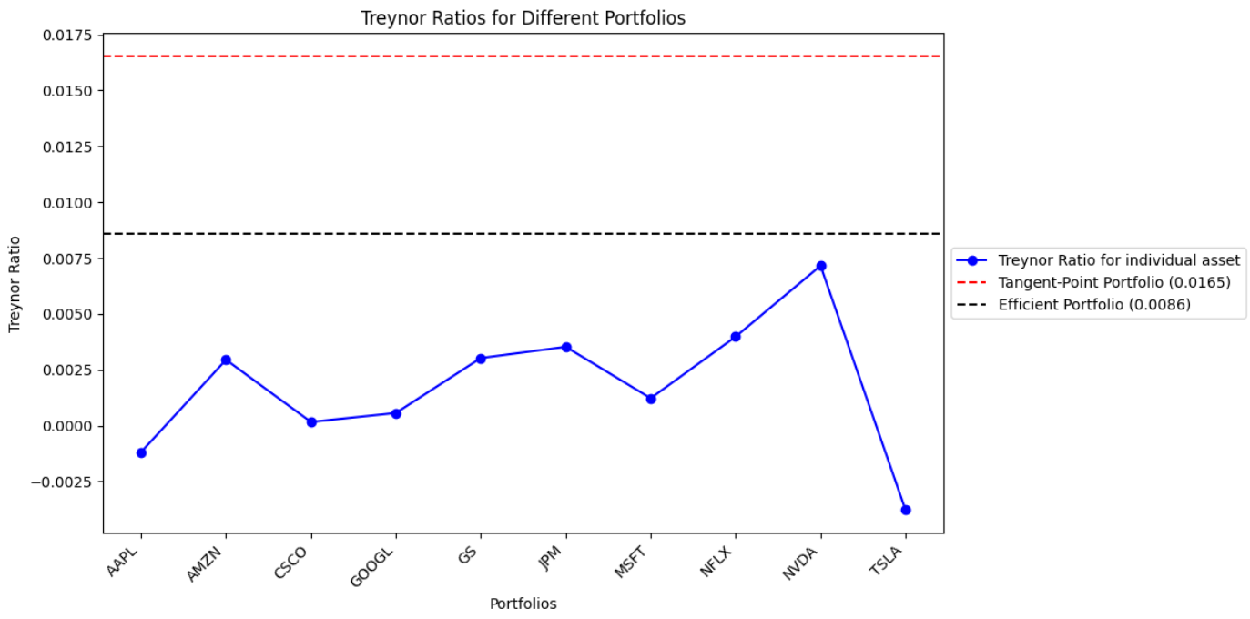
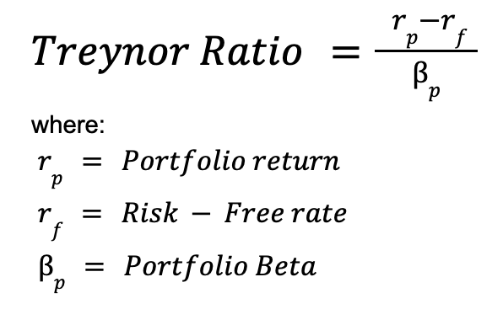
Treynor Ratio
It is a measurement of the returns earned in excess of that which could have been earned on an investment that has no diversifiable risk

Slide 17
Implication of Performance Metrics
Comparing Sharpe and Treynor Ratios of individual assets to those of optimized portfolios helps assess if portfolios offer superior risk-adjusted returns compared to holding individual assets.
Higher ratios for portfolios indicate improved risk-adjusted performance, suggesting that combining assets has benefits.
Lower ratios for portfolios suggest that individual assets may offer better risk-adjusted returns.
These measures aid investors in evaluating portfolio efficiency by considering both returns and risks.
They assist in decision-making for portfolio allocation and management by providing insights into the performance of different portfolios.

Slide 18
Markowitz vs CAPM
Markowitz Approach:
Focuses on optimizing portfolios based on the trade-off between risk and return.
Utilizes mean-variance analysis to identify portfolios that offer the highest expected return for a given level of risk or the lowest risk for a desired level of return.
Diversification is key, aiming to combine assets with low or negative correlations to reduce overall portfolio risk.
Allows for the creation of efficient frontiers to visualize the set of optimal portfolios.
The main insight is the emphasis on diversification to reduce risk while maximizing returns.
CAPM Approach:
Relies on the Capital Asset Pricing Model (CAPM) to determine expected returns for assets based on their systematic risk.
Assumes that investors are rational and risk-averse, seeking higher returns for higher levels of systematic risk.
Provides a single-factor model that considers the relationship between an asset's beta (systematic risk) and expected return.
The risk-free rate and the market risk premium are key inputs for calculating expected returns.
The main insight is the consideration of systematic risk and the market risk premium in determining expected returns.

Slide 19
Key Insights:
Markowitz Approach: Emphasizes the benefits of diversification and the efficient frontier, allowing investors to construct portfolios tailored to their risk preferences.
CAPM Approach: Highlights the importance of systematic risk and the market risk premium in determining asset returns, providing a more straightforward framework for estimating expected returns based on beta.
Comparison:
While both approaches aim to optimize portfolios, they differ in their methodologies and underlying assumptions.
Markowitz focuses on diversification and the mean-variance trade-off, accommodating various levels of risk aversion and return expectations.
CAPM provides a more simplified model based on systematic risk and market equilibrium, offering a more straightforward approach to estimating expected returns.
Markowitz is more flexible and adaptable to different investment objectives and preferences, whereas CAPM provides a more standardized approach based on market principles

Slide 20
Contrast:
Markowitz allows for a broader range of assets and considers their covariance structure, whereas CAPM focuses solely on systematic risk and the relationship between beta and expected return.
Markowitz provides a more comprehensive framework for portfolio optimization, while CAPM offers a simpler, single-factor model for estimating expected returns.
Summary: Both approaches offer valuable insights into portfolio construction and risk-return trade-offs, with Markowitz providing more flexibility and customization and CAPM offering a more streamlined and market-based approach to estimating expected returns. The choice between the two depends on the investor's preferences, risk tolerance, and the level of complexity desired in portfolio optimization.

Slide 21
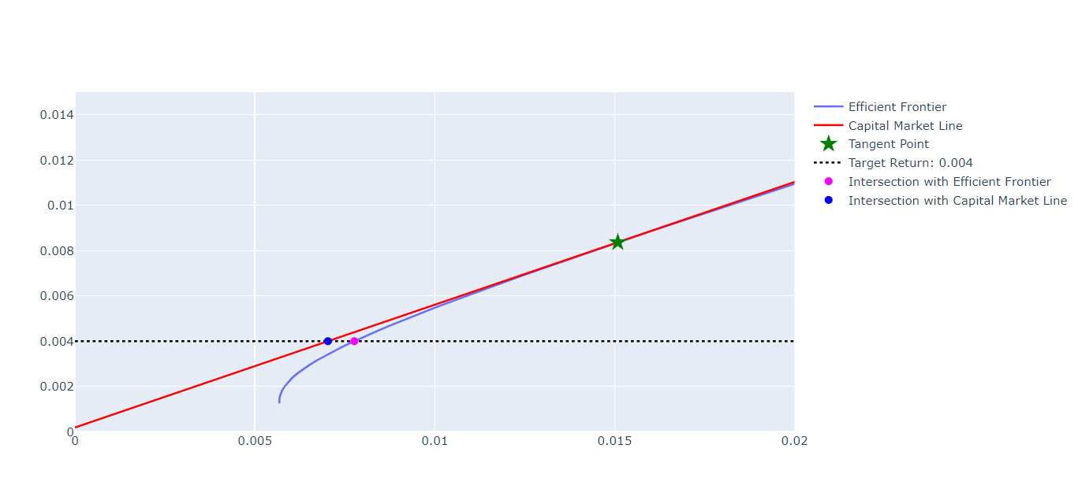
Markowitz vs CAPM
Plot inference summary- CAPM is more complex but better results in comparison to the Markowitz

Slide 22
THANK YOU

